Slide 1
Business Forecasting Project
By Tanush Bhaskar Shetty

Slide 2
State your forecasting question and its importance to you
What will be the total weekly sales across all given Walmart stores in dataset for the next 10 weeks, and how can this forecast inform better business decisions?

Slide 3
Describe the data
The dataset contains weekly sales data for Walmart stores across the United States.
Structure of the Dataset
Store: Unique identifier for each Walmart store.
Date: The week-ending date for the sales data.
Weekly_Sales: Total sales for the store in a specific week.
Holiday_Flag: Binary indicator (1 if the week includes a major holiday; 0 otherwise).
Temperature: Average temperature (in Fahrenheit) for the week.
Fuel_Price: Weekly average fuel price (in dollars per gallon).
CPI: Consumer Price Index, indicating changes in the cost of goods and services.
Unemployment: Unemployment rate for the region.

Slide 4
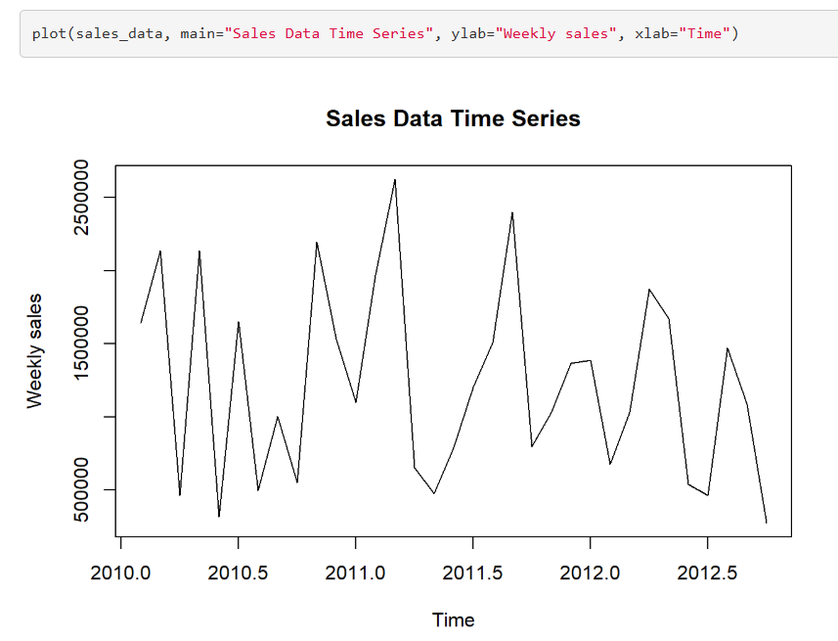
Insights from Exploratory Data Analysis
Overall Trend: The graph shows a general upward trend in sales over time. This indicates that, despite the weekly fluctuations, there has been an overall increase in sales from 2010 to mid-2012.
Seasonal Patterns: There appear to be recurring peaks and troughs, suggesting seasonal patterns. These could correspond to specific times of the year when sales typically increase or decrease.

Slide 5
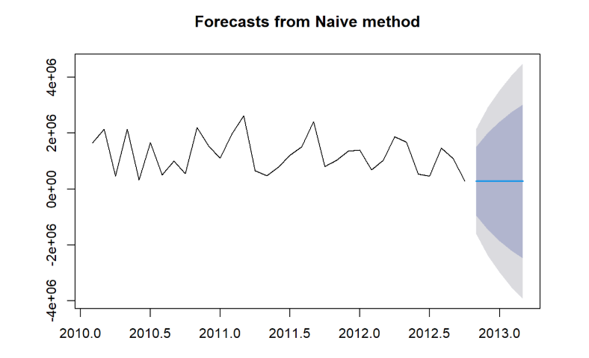
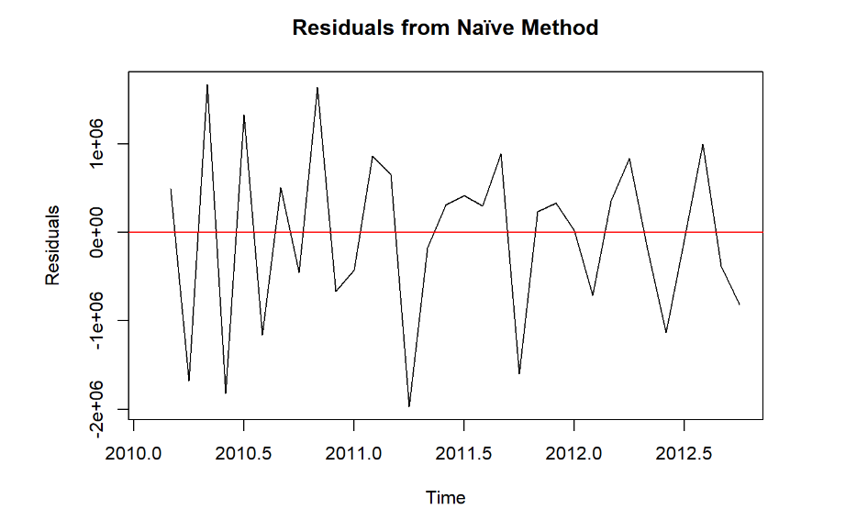
Insights from different forecasting methods and their residual analysis
Sales data shows strong and predictable seasonal patterns.
The residuals fluctuate around the zero line, suggesting that the Naive method produces unbiased forecasts on average. This means there isn't a consistent overestimation or underestimation of the sales data.

Slide 6
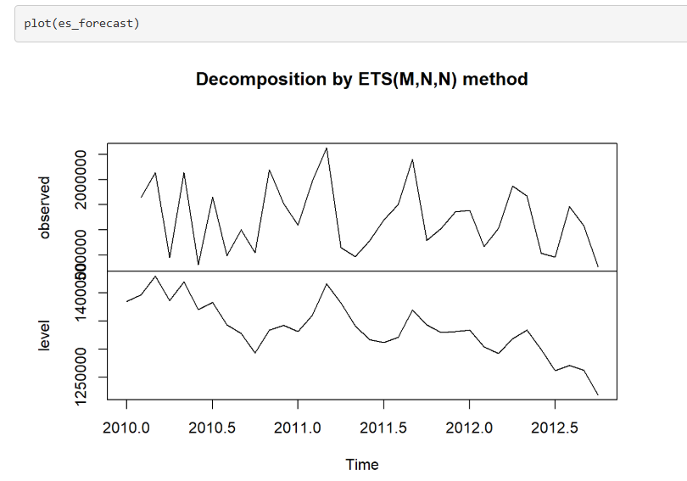
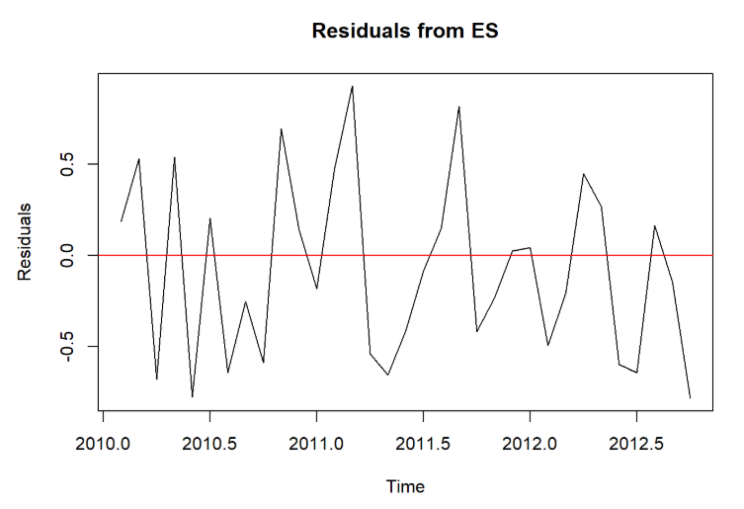
Exponential Smoothing (ETS) method
The level (or trend) component reveals an overall downward trend. This indicates that the underlying trend in sales data is decreasing over time, even though there are fluctuations.
The residuals fluctuate around the zero line, indicating that the ES model produces forecasts that are unbiased on average. This means there's no systematic overestimation or underestimation in the forecasts.

Slide 7
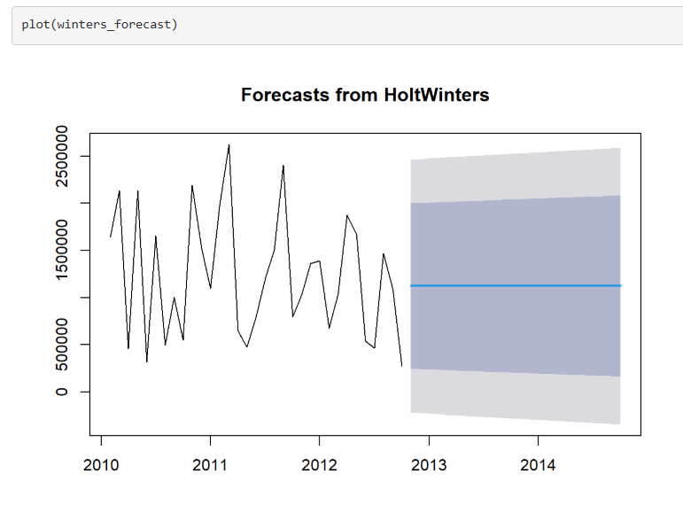
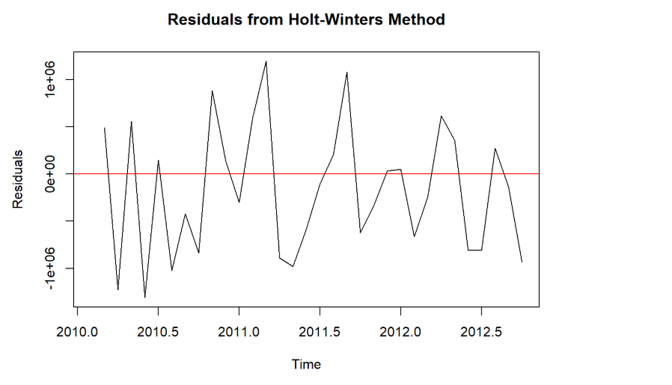
Holt Winters method
The plot displays a noticeable upward trend in the sales data over time, indicating that sales are generally increasing. This suggests a positive growth trend in your business.
The residuals fluctuate around the zero line, suggesting that the Holt-Winters method produces unbiased forecasts on average. This means there isn't a consistent overestimation or underestimation of the sales data.

Slide 8
Prediction and Accuracy summary from different forecasting methods
Naive method
The forecast assumes no change; the last observed value is repeated.
High values of RMSE and MAE suggest that the forecast errors are significant. This indicates that while the Naive model might capture some trends, it may not be sufficiently accurate for precise forecasting.
A MAPE value over 100% indicates substantial errors in percentage terms, implying that the model's forecasts deviate significantly from actual values.

Slide 9
Simple Exponential Smoothing method
This forecast model might capture some trends, it may not be sufficiently accurate for precise forecasting.
Also according to accuracy measures the model's forecasts deviate significantly from actual values by 80%

Slide 10
Holt Winters method
The plot in previous slide displays a noticeable upward trend in the sales data over time, indicating that sales are generally increasing. This suggests a positive growth trend in your business.
This forecast model might capture some trends, it may not be sufficiently accurate for precise forecasting.
Also according to accuracy measures the model's forecasts deviate significantly from actual values by 73.38%

Slide 11
Decision
Holt-Winters Seasonal Method
The best method for this dataset. It accounts for both trends and seasonality, which are essential when forecasting Walmart sales. Retail sales tend to show strong seasonal patterns, especially around holidays or specific promotional periods. The Holt-Winters method’s ability to adjust for both trend and seasonality provides the most accurate and reliable forecasts.
Decision: This method is the recommended choice for this dataset due to its flexibility and ability to capture both seasonal variations and trends.

Slide 12
Ideas to improve your forecasts
To improve the forecasts for Walmart sales, you can consider the following strategies
1. Decompose the Time Series Further
Separate trend, seasonal, and residual components. By better understanding the individual components, you can apply different models to each component This helps isolate any unwanted components in the data, improving the forecast's overall accuracy.
2. Use Higher Frequency Data (Daily or Hourly)
If feasible, one can consider using daily or even hourly data for your forecasts, rather than weekly data. This can provide more granular insights into sales patterns, especially during high-traffic periods like weekends, holidays, or special sales events.

Slide 13
Thank you

